Slide 1
Social Science considerations in Civil Engineering
CE 4200
Professional Engineering Practice Issues
Fall 2021 Semester
William D. Lawson, PE, PhD

Slide 2
BASIS FOR THIS LECTURE
Social Science Considerations in Civil Engineering
CE 4200: Professional Engineering Practice Issues
Fall 2021 Semester
William D. Lawson, PE, PhD

Slide 3


CIVIL ENGINEERING: A People-Serving Profession

Slide 4
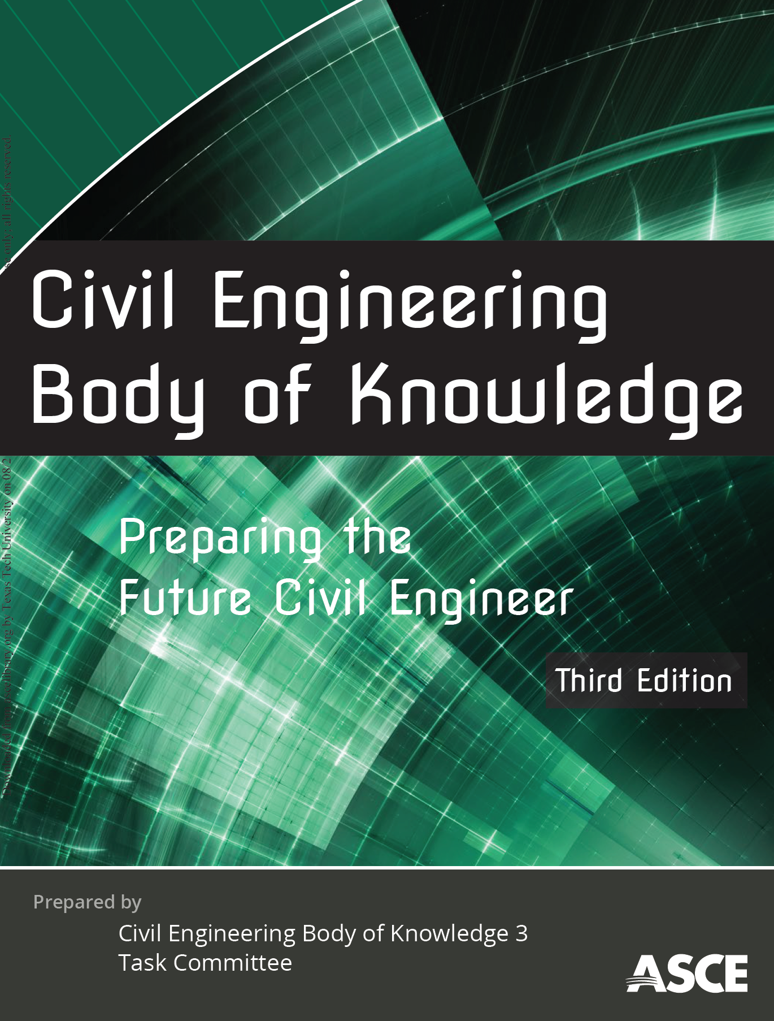
BOK3E Outcomes
Mathematics
Natural Sciences
Social Sciences
Humanities
Materials Science
Engineering Mechanics
Experimental Methods and Data Analysis
Critical Thinking and Problem Solving
Project Management
Engineering Economics
Risk and Uncertainty
Breadth in Civil Engr Areas
Design
Technical Depth
Sustainability
Communication
Teamwork and Leadership
Professional Attitudes
Lifelong Learning
Ethical Responsibility
Professional Responsibilities

Slide 5
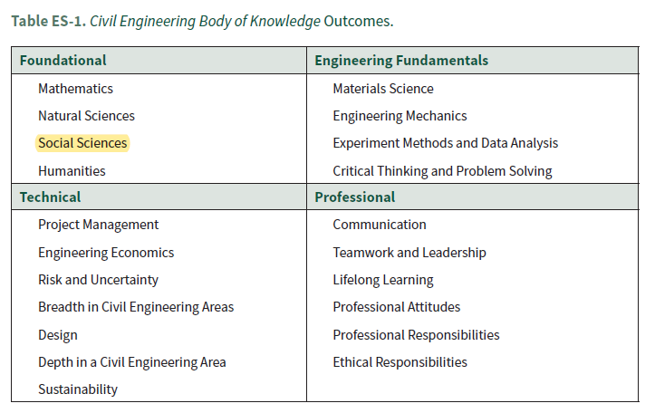
Social Sciences CE BOK 3rd Edition

Slide 6
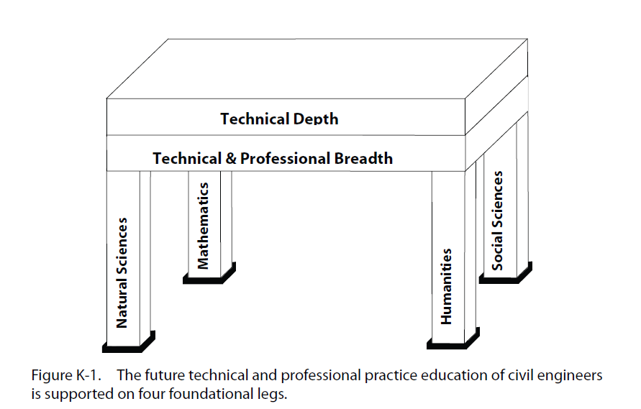
CIVIL ENGINEERING
PROFESSIONAL PRACTICE
APPENDIX K:
HUMANITIES AND SOCIAL SCIENCES
(ASCE BOK2E)

Slide 7
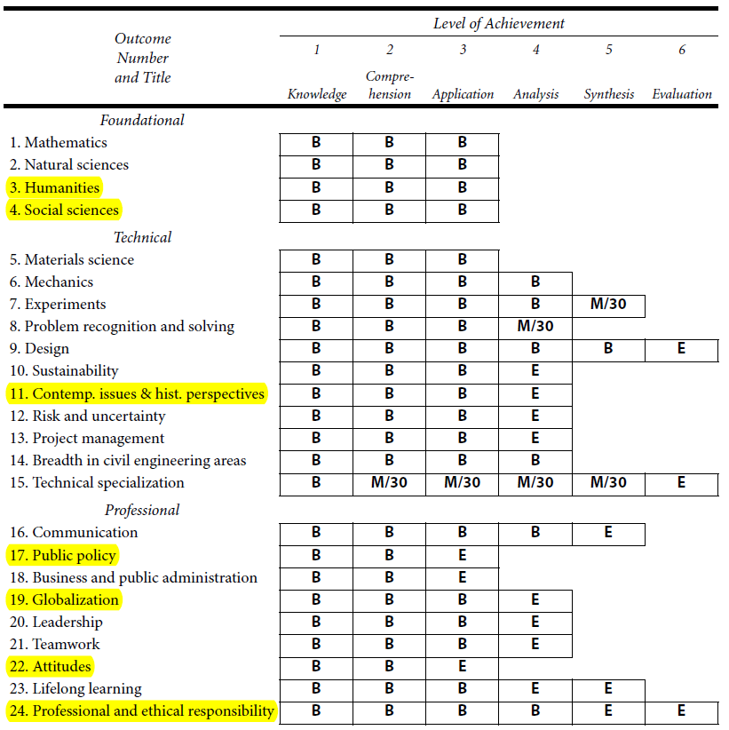

Slide 8
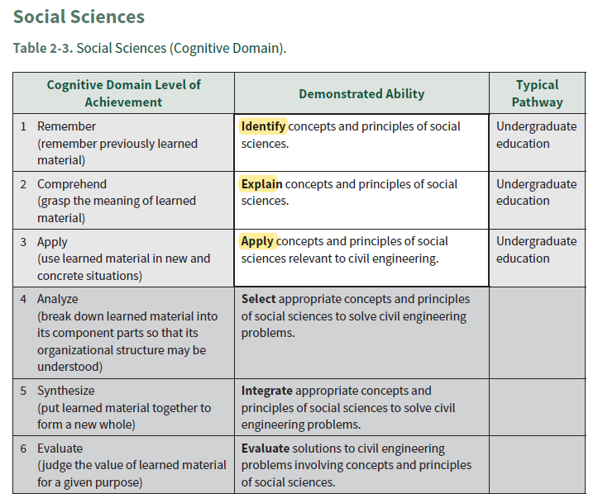
Social Sciences CE BOK 3rd Edition

Slide 9
SOME DEFINITIONS
Social Science Considerations in Civil Engineering
CE 4200: Professional Engineering Practice Issues
Fall 2021 Semester
William D. Lawson, PE, PhD

Slide 10
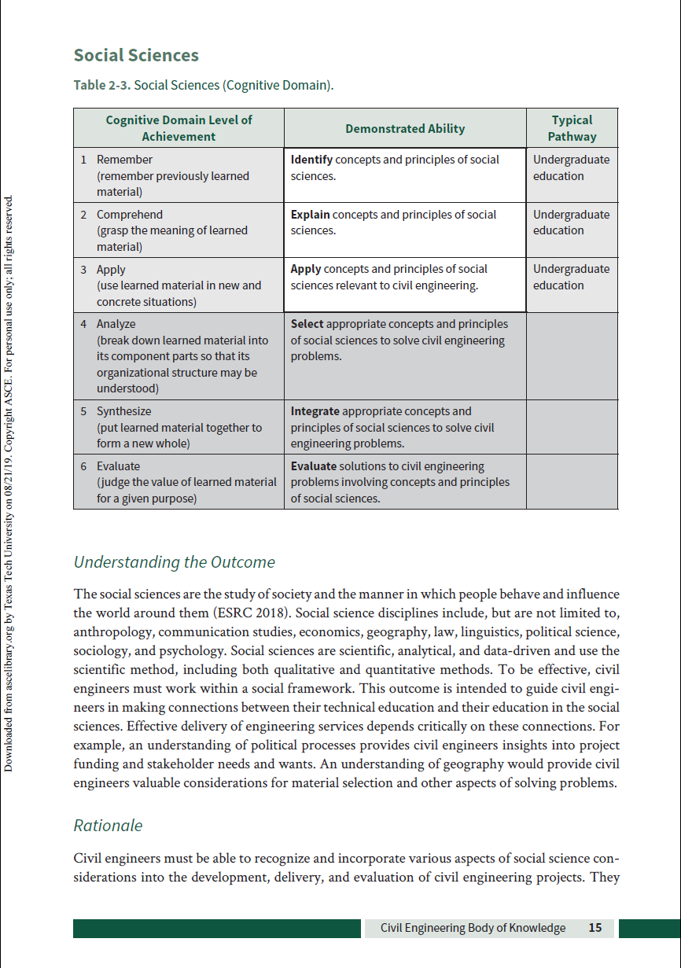

Slide 11

Social Sciences… Definition
“Engineering services are delivered to society through social mechanisms and institutions. The social sciences are the systematic study of these social phenomena… Understanding [this] social framework is foundational to effective professionalism”
~ ASCE BOK2E

Slide 12
Social Sciences… Definition
“Social science is an academic discipline concerned with society and the relationships among individuals within a society, which often rely primarily on empirical approaches.”
~ ScienceDaily

Slide 13
Social Sciences… Definition
“Social science [is] any discipline or branch of science that deals with human behavior in its social and cultural aspects. The social sciences include cultural (or social) anthropology, sociology, social psychology, political science, and economics.”
~ Encyclopedia Britannica

Slide 14
Social Sciences… Definition
“The social sciences study the common elements and collective dimensions of the human experience.”
~ Berkeley College of Letters & Science

Slide 15
A BRIEF QUIZ
Social Science Considerations in Civil Engineering
CE 4200: Professional Engineering Practice Issues
Fall 2021 Semester
William D. Lawson, PE, PhD

Slide 16

QUIZ: Major Engineering Disasters
SCOPE
Relatively modern history, not necessarily the biggest failures
Most (but not all) in the United States
Most (but not all) related to Civil Engineering
QUESTIONS
How many people perished in these disasters?
Are you familiar… with the lessons learned?

Slide 17
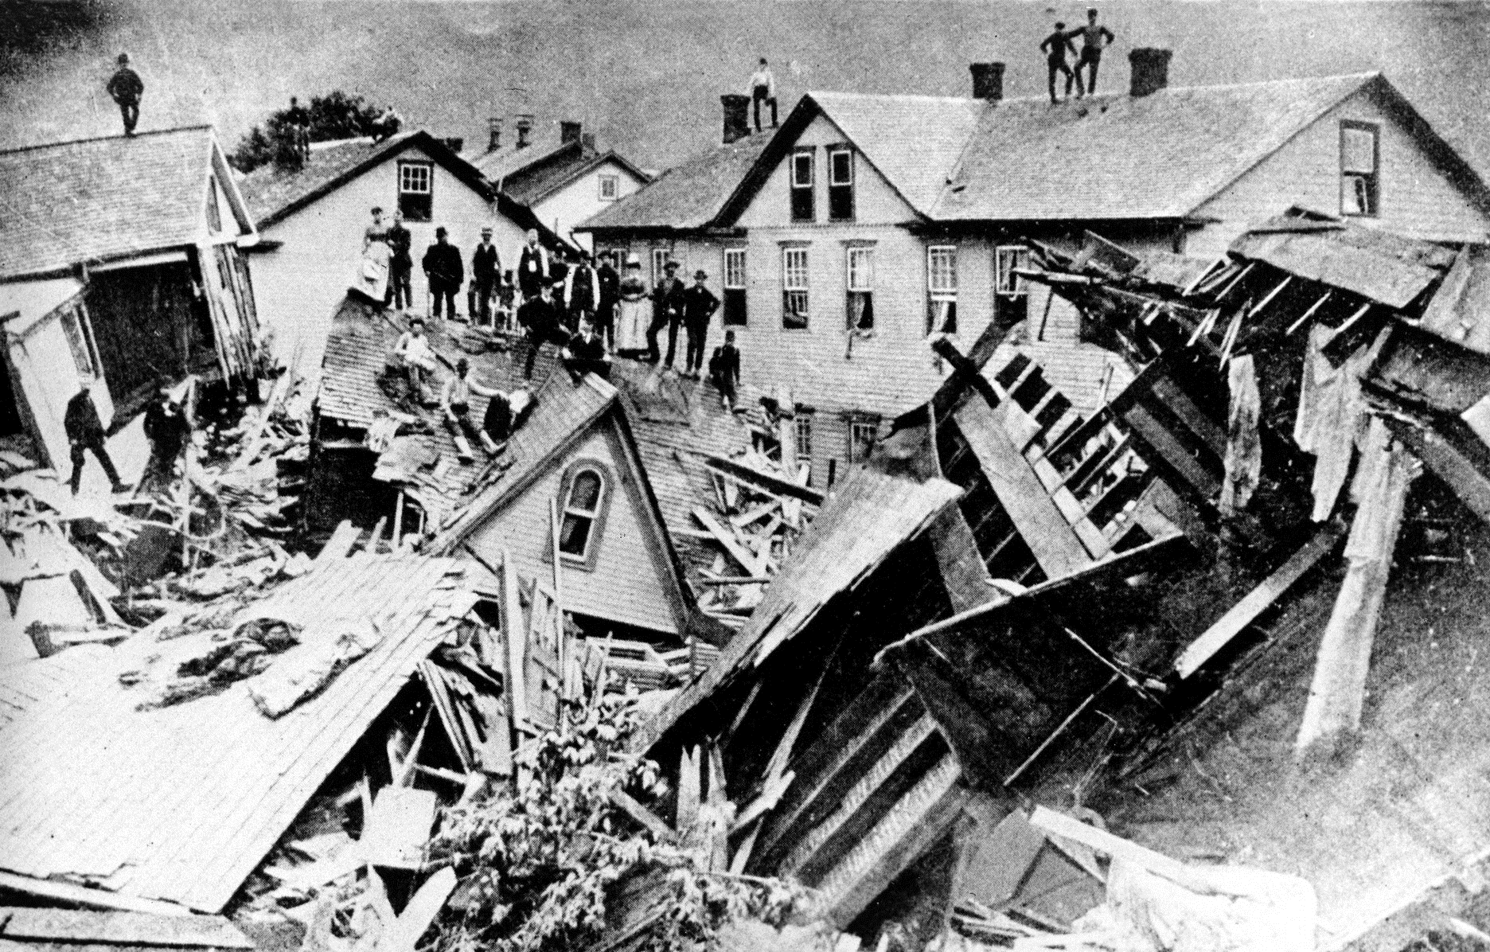
South Fork Dam (1889) Johnstown, Pennsylvania
2,209

Slide 18
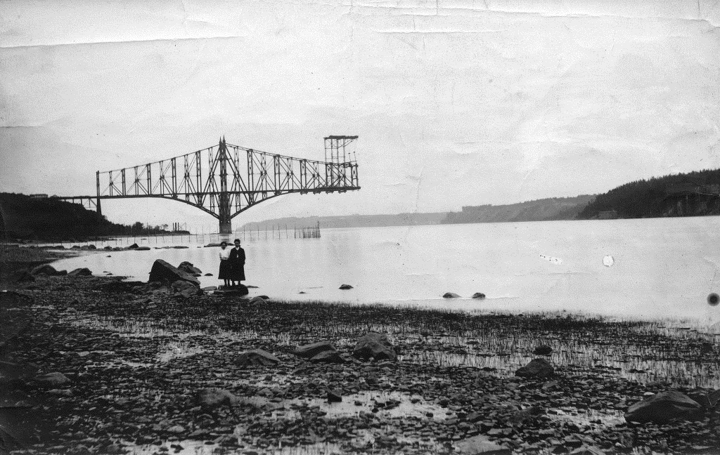
Quebec Bridge (1907) Quebec City, Canada
75

Slide 19
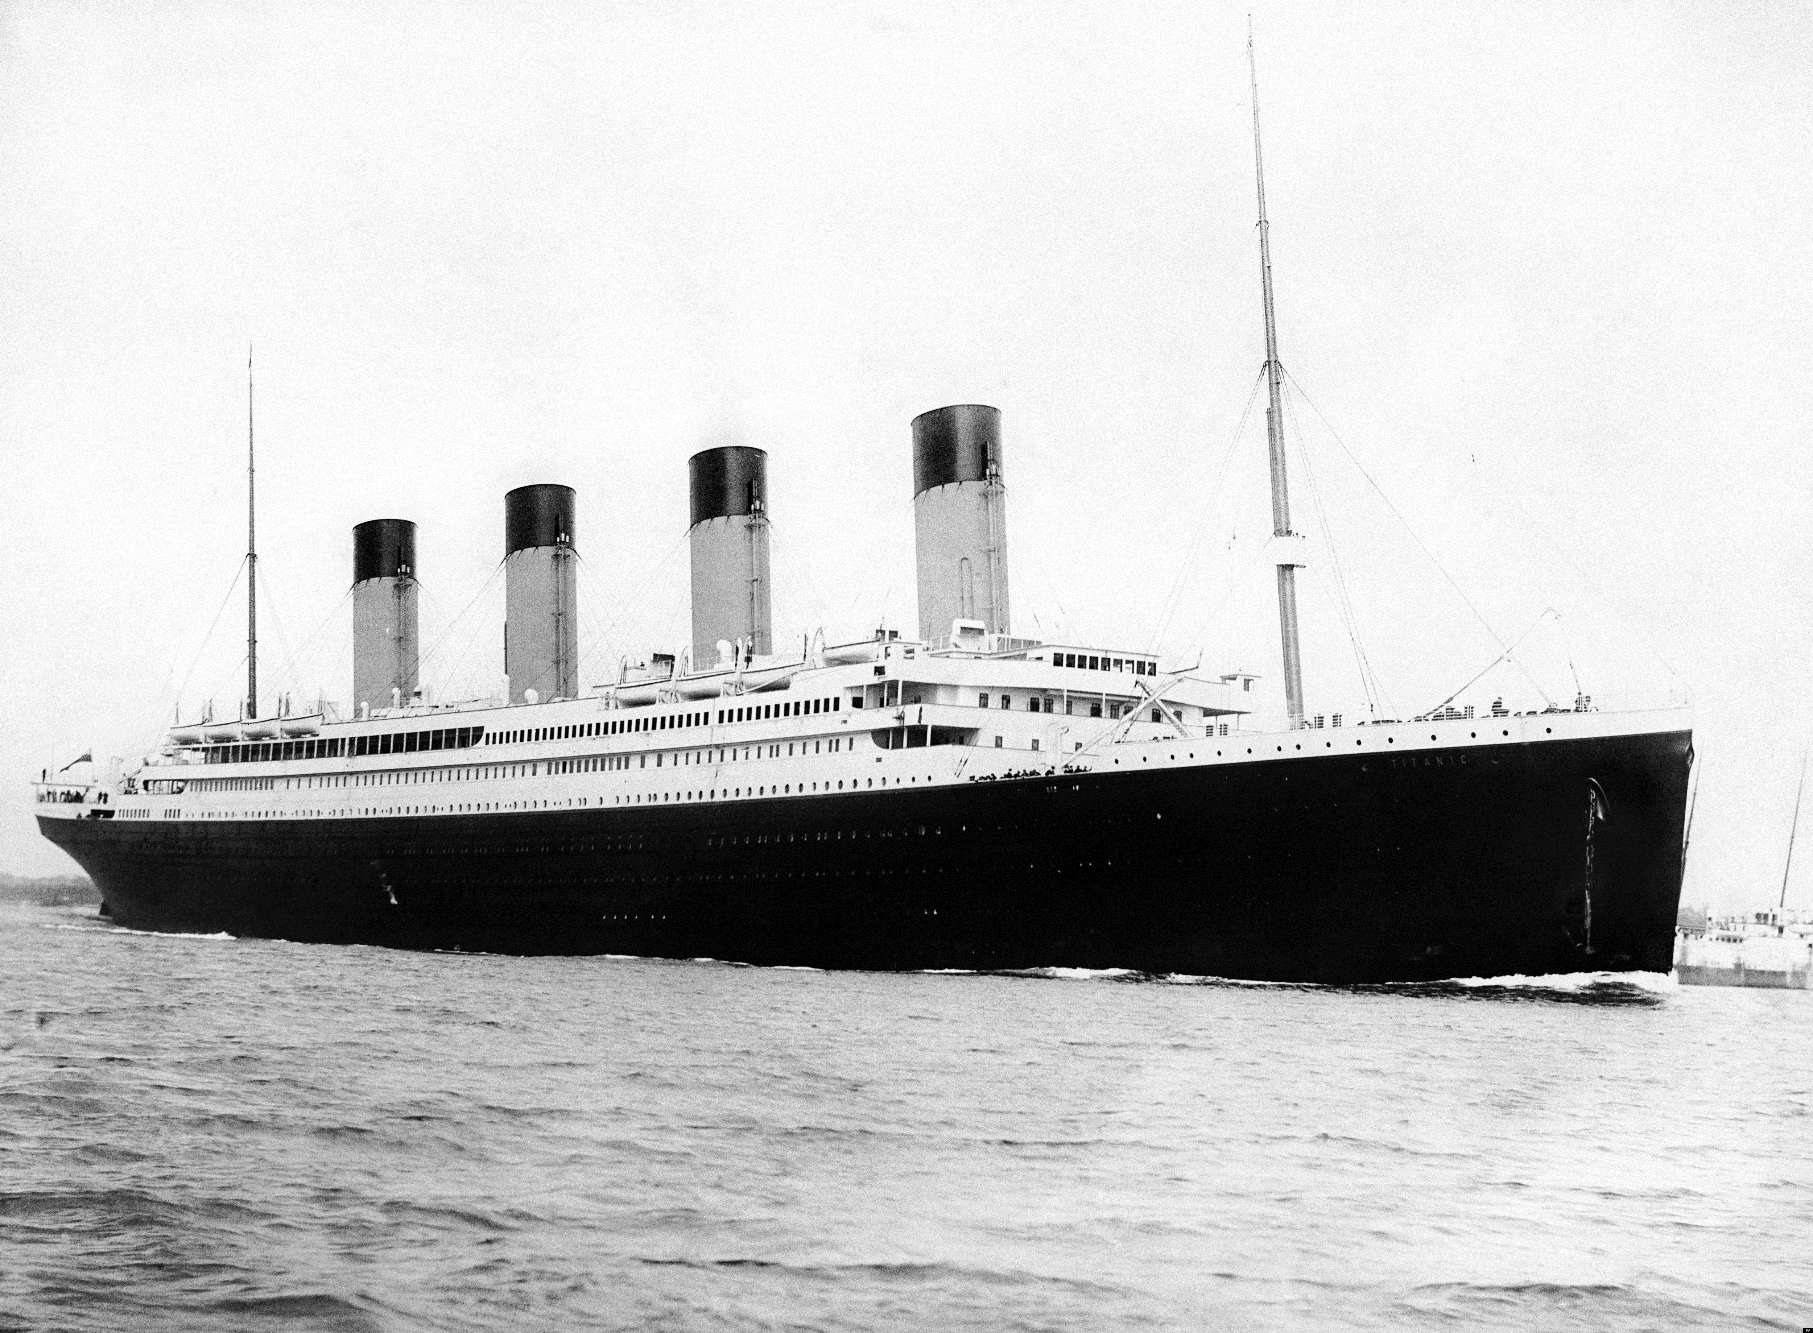
RMS Titanic (1912) North Atlantic Ocean (41°43′55″N 49°56′45″W)
1,517

Slide 20
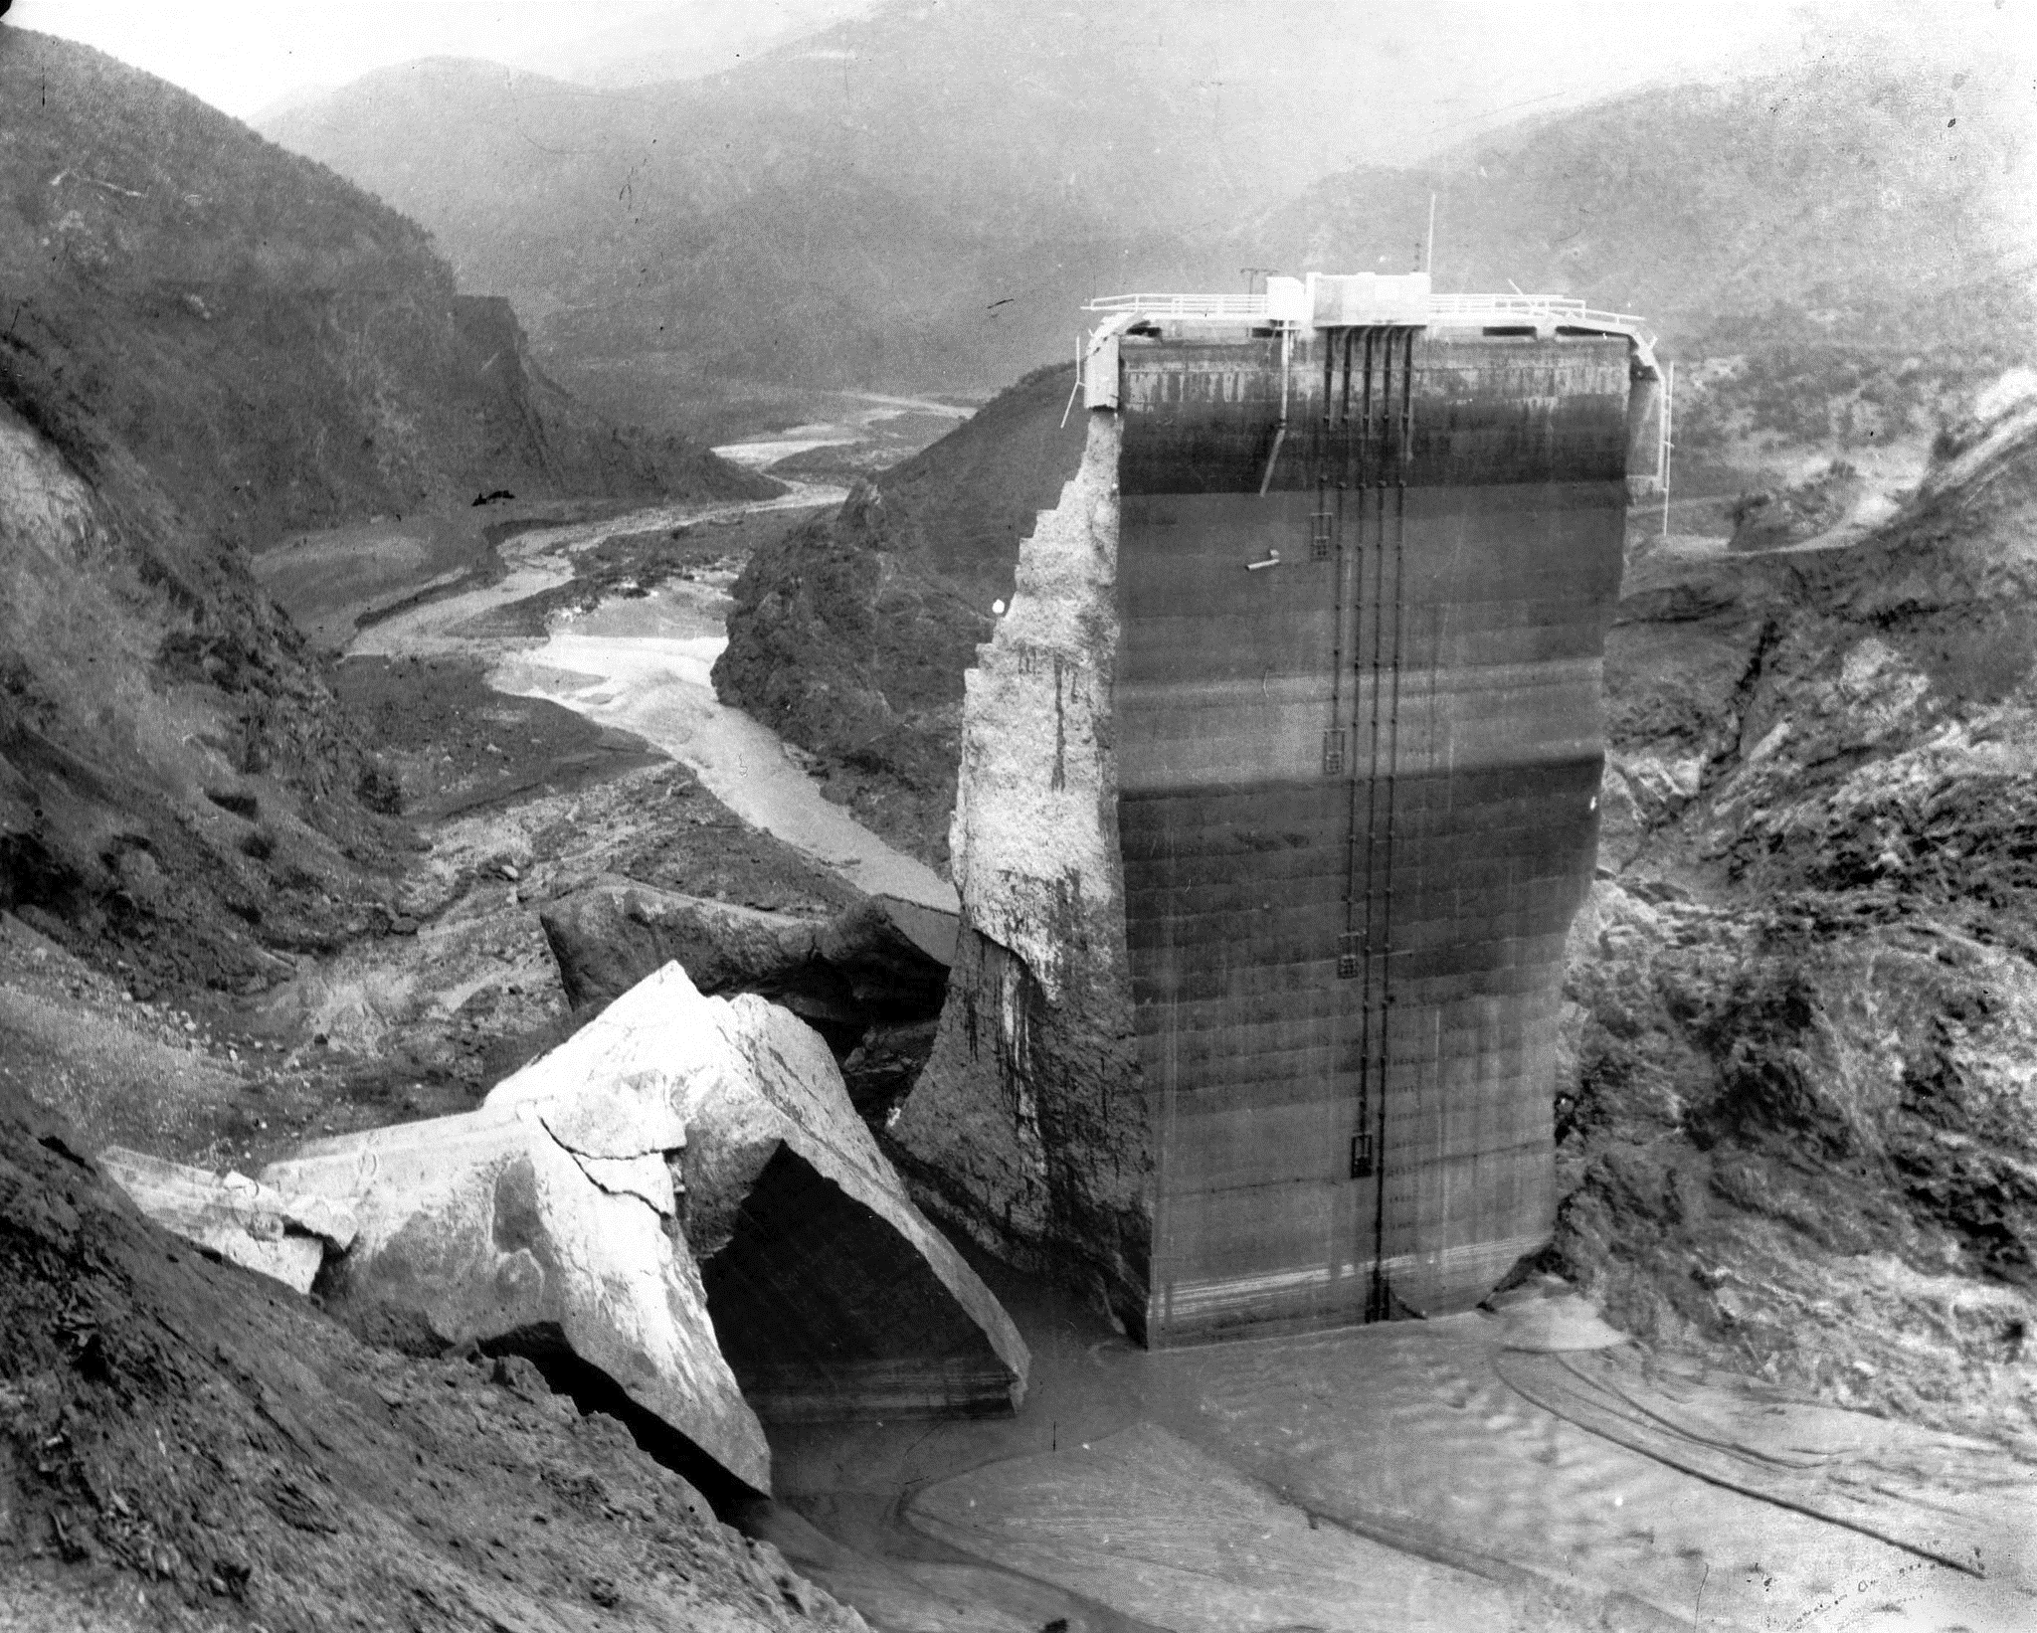
St. Francis Dam (1928) Santa Clarita, California
600

Slide 21
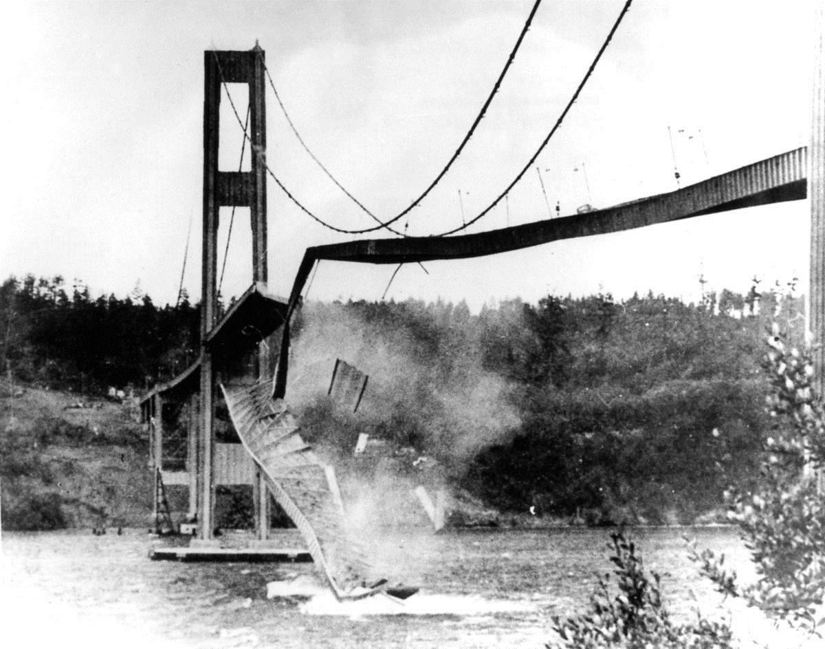
Tacoma Narrows Bridge (1940) Tacoma, Washington
0

Slide 22
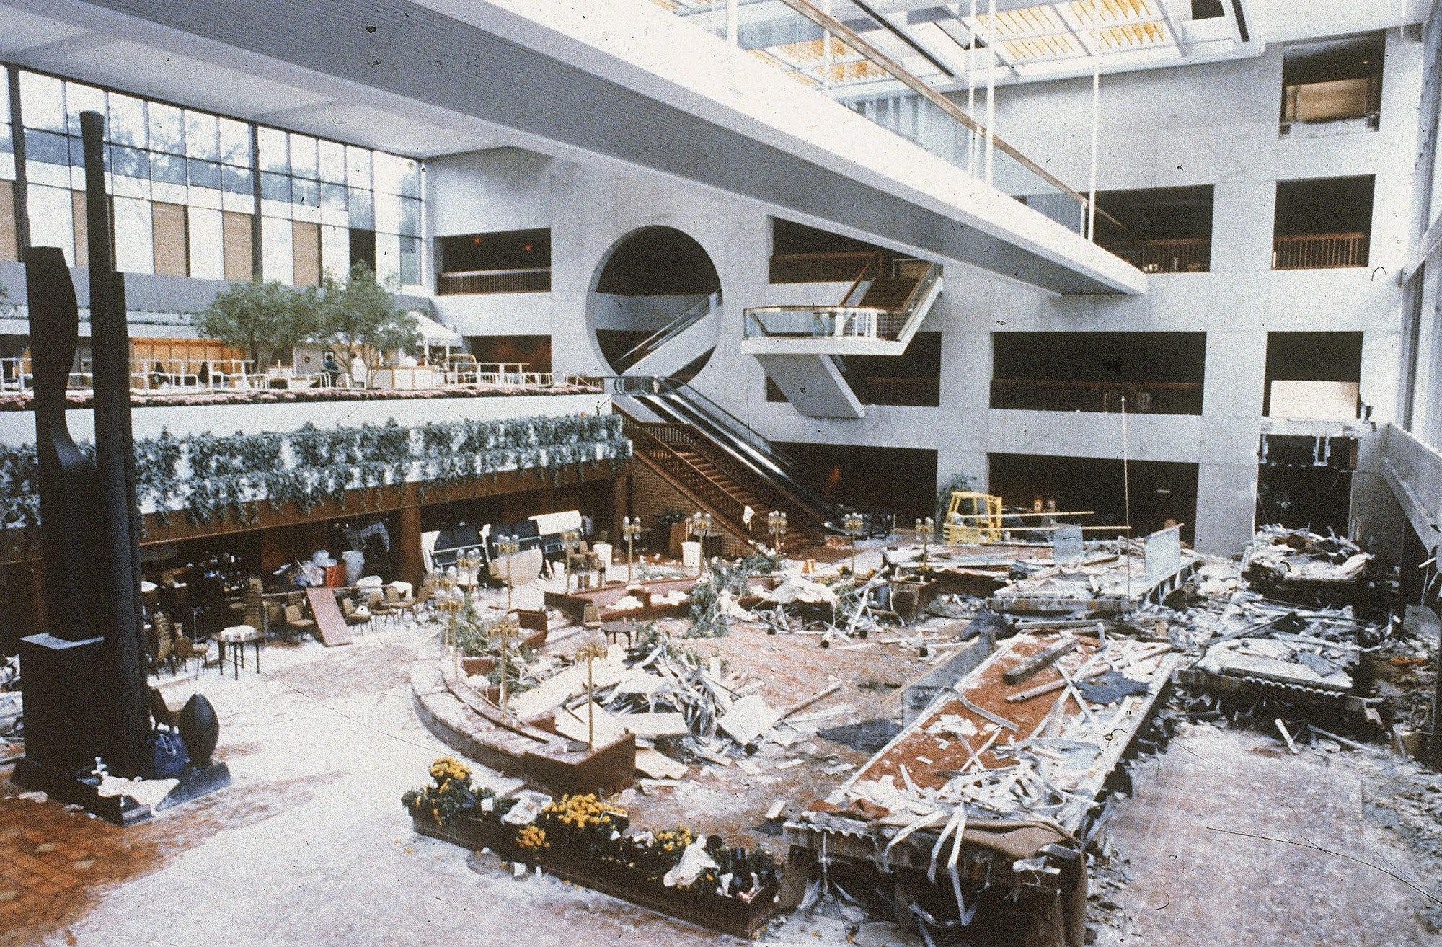
Hyatt Regency Hotel Walkway Collapse (1981) Kansas City, Missouri
114

Slide 23
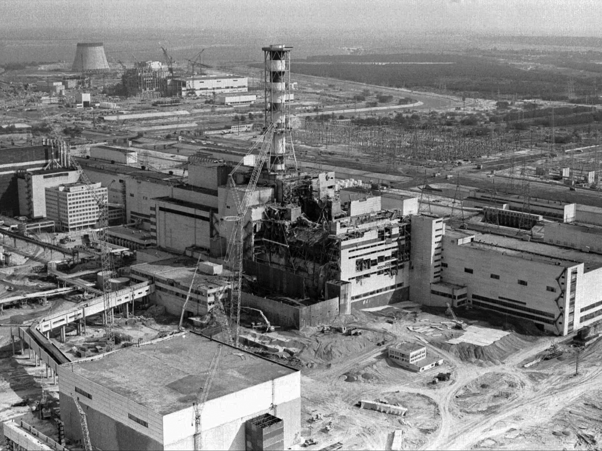
Chernobyl Nuclear Power Plant (1986) Pripyat, Ukraine, Soviet Union
31

Slide 24
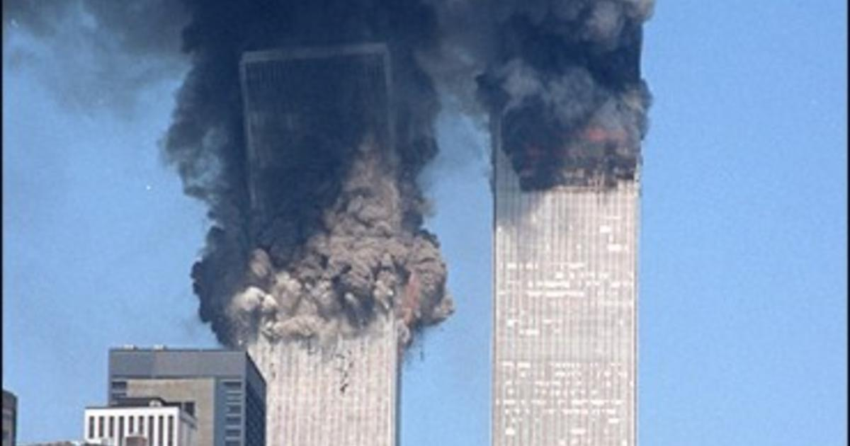
World Trade Center (2001) New York City, New York
2,743

Slide 25

Space Shuttle Columbia Disaster (2003) over Northeast Texas and Louisiana
7

Slide 26
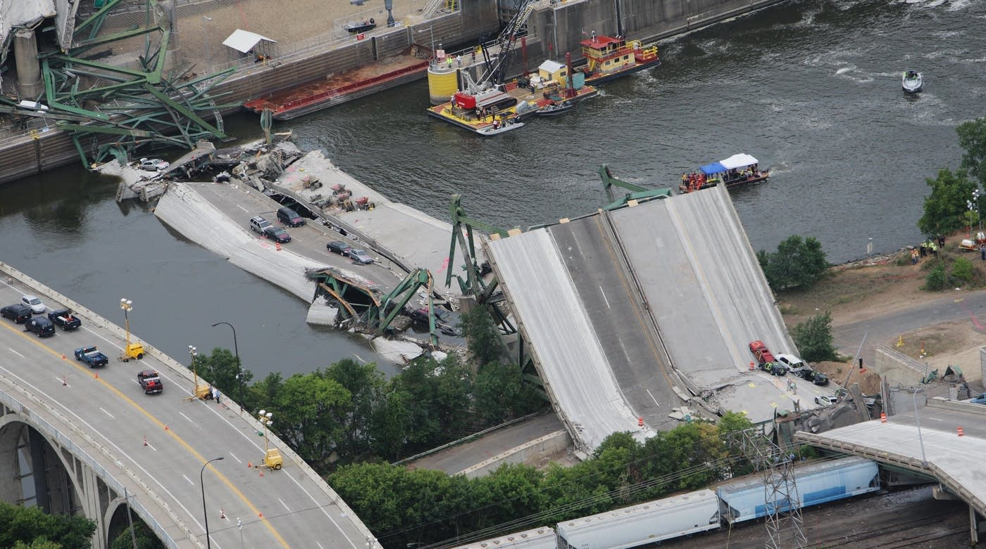
I-35W Mississippi River Bridge (2007) Minneapolis, Minnesota
13

Slide 27
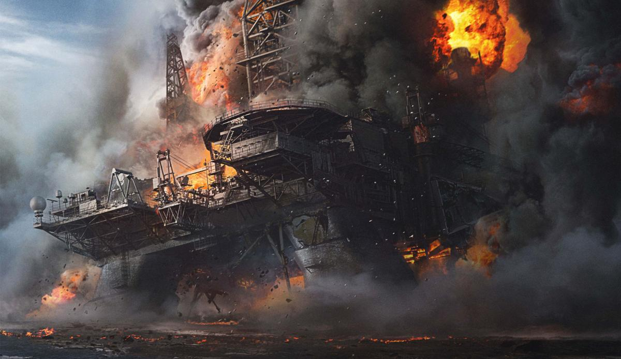
Deepwater Horizon (2010) Gulf of Mexico, USA
11

Slide 28
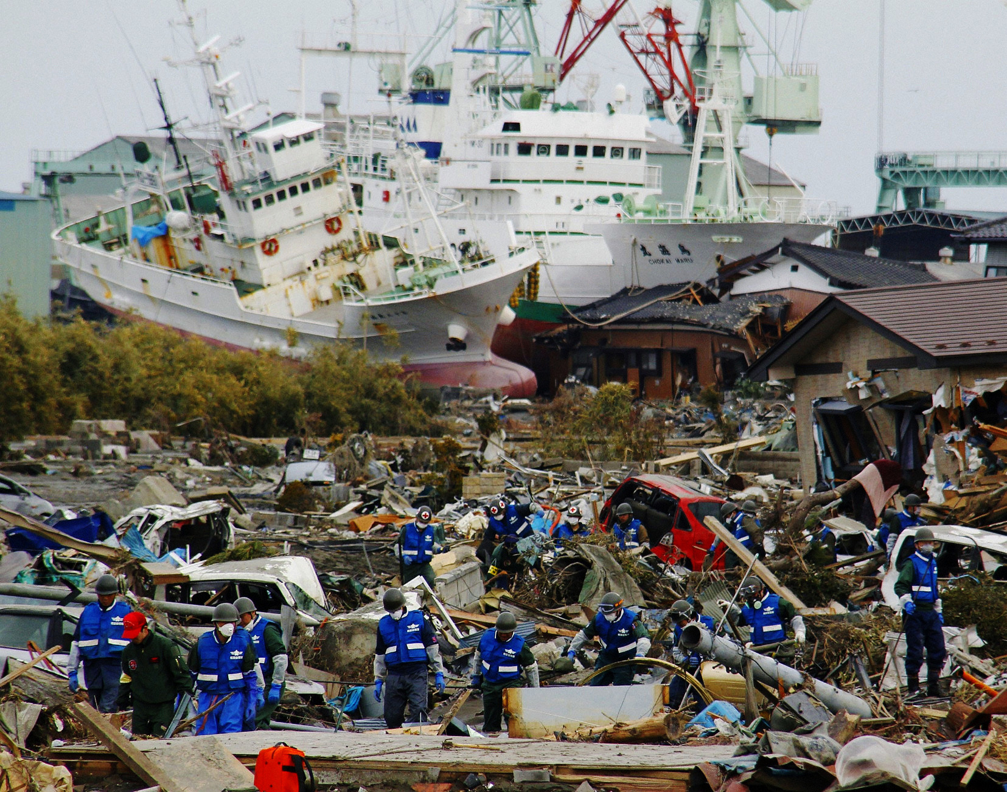
Tōhoku Earthquake and Tsunami (2011) Oshika Peninsula, Japan
15,896

Slide 29
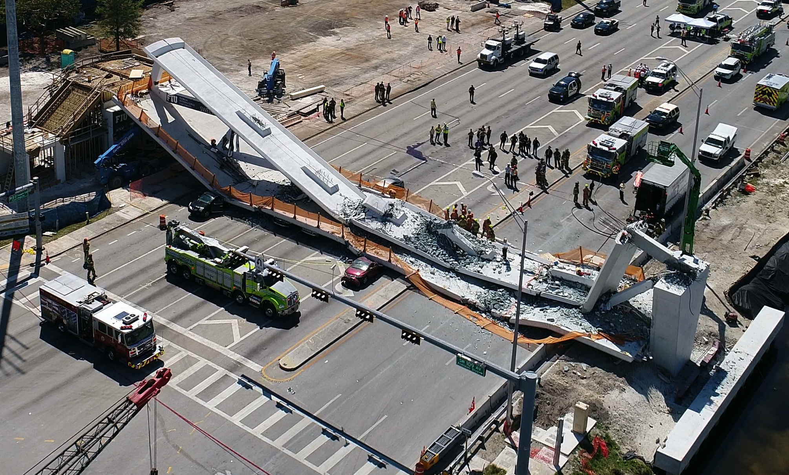
Florida International Pedestrian Bridge (2019) Miami, Florida
6

Slide 30
From the Historical Record…
Engineering Disaster | Deaths |  | Engineering Disaster | Deaths
South Fork Dam | 2,209 |  | Chernobyl Nuclear Plant | 31
Quebec Bridge | 75 |  | World Trade Center | 2,743
RMS Titanic | 1,517 |  | Space Shuttle Columbia | 7
St. Francis Dam | 600 |  | I-35W Mississippi Bridge | 13
Tacoma Narrows Bridge | 0 |  | Deepwater Horizon | 11
Hyatt Regency Walkway | 114 |  | Tōhoku Quake & Tsunami | 15,896
 |  |  | Florida Pedestrian Bridge | 6

Slide 31
Engineers shall hold paramount
the safety, health and welfare
of the public.
Fundamental Canon 1
NSPE Code of Ethics for Engineers

Slide 32
Some Civil Engineering / Social Science Vignettes
Social Science Considerations in Civil Engineering
CE 4200: Professional Engineering Practice Issues
Fall 2021 Semester
William D. Lawson, PE, PhD

Slide 33

Admiral William H. McRaven

Slide 34
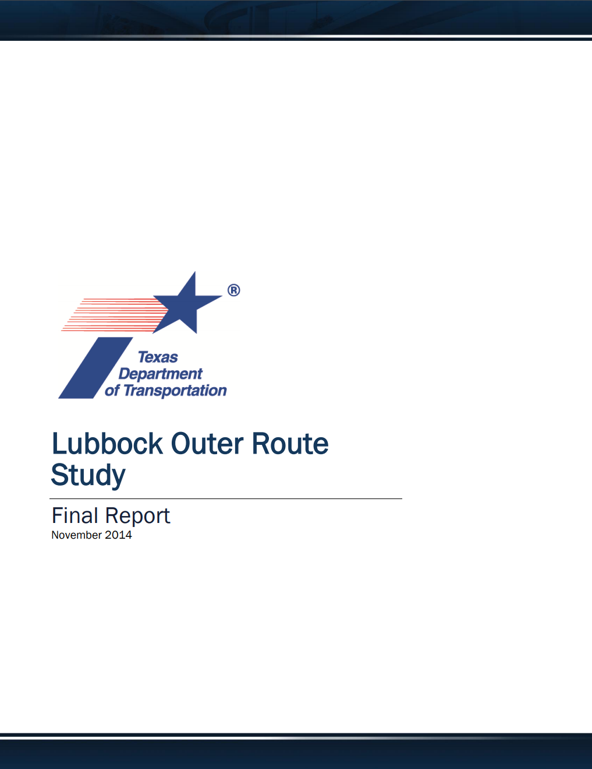
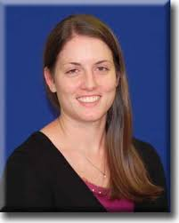
Guest Lecture Kylan Francis, PE Director, Transportation Planning & Development TxDOT Lubbock

Slide 35
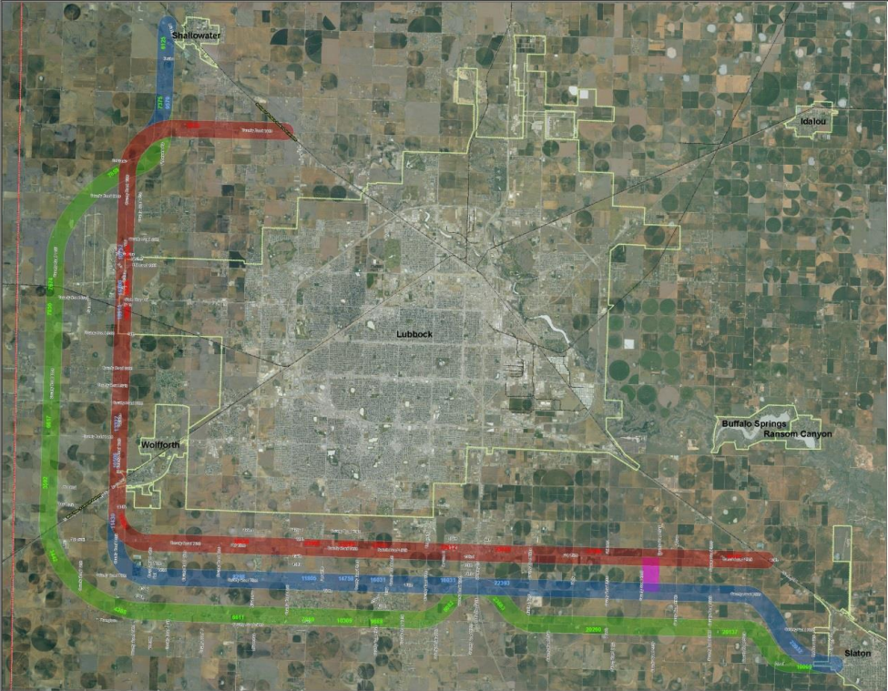
Texas Loop 88 Lubbock, TX

Slide 36

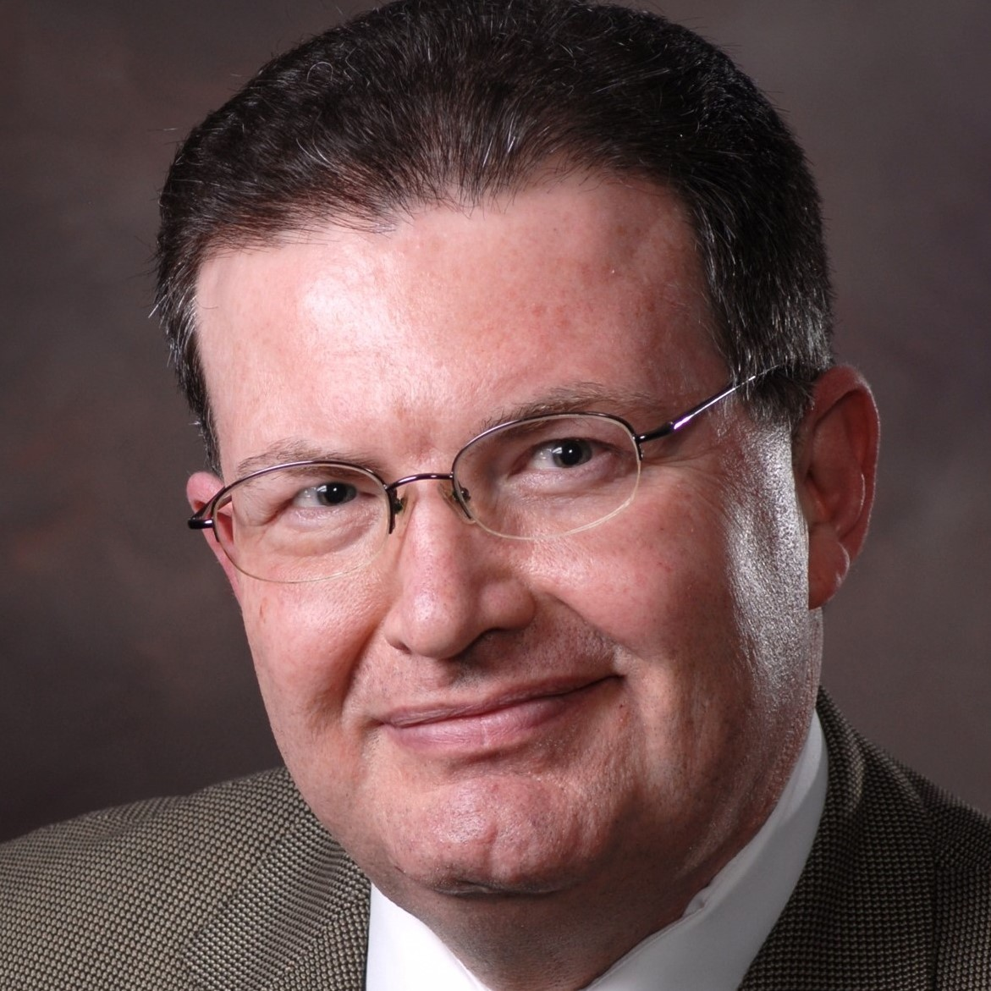
Technical Report Aubrey A. Spear, PE, et al. City of Lubbock Water Utilities Lubbock, Texas

Slide 37
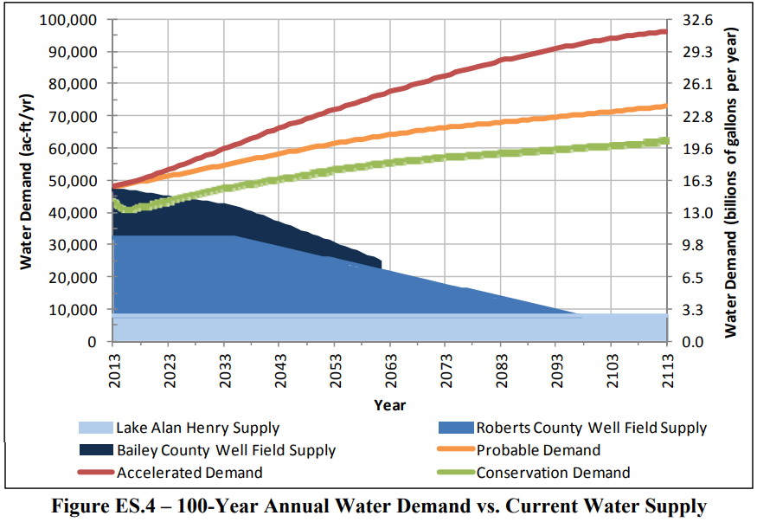
Meeting our increasing demand for water…

Slide 38
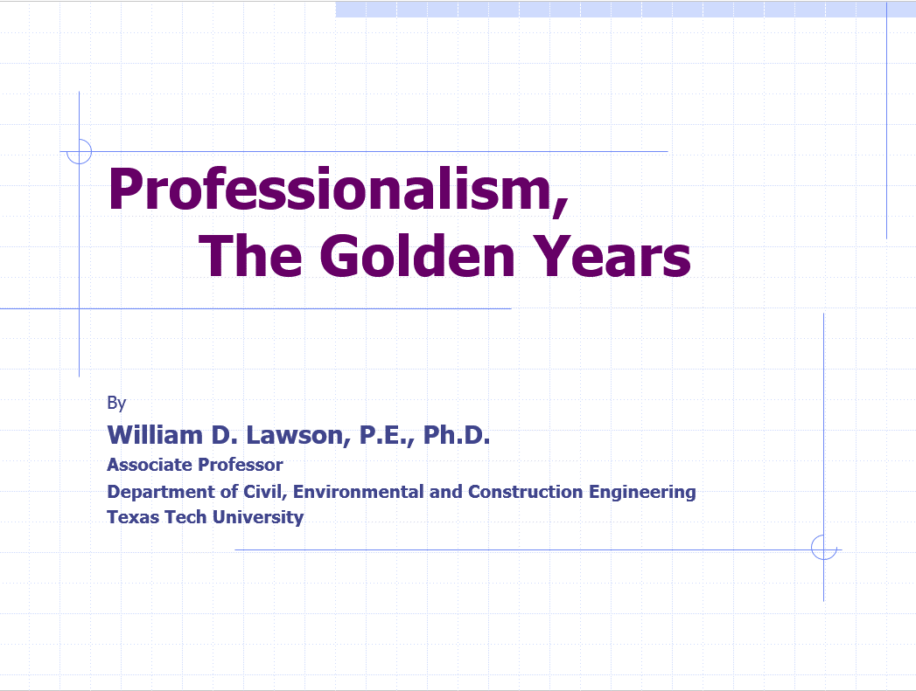
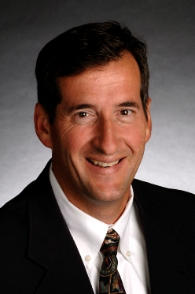
Topic Lecture William D. Lawson, PE, PhD Associate Professor Texas Tech University

Slide 39
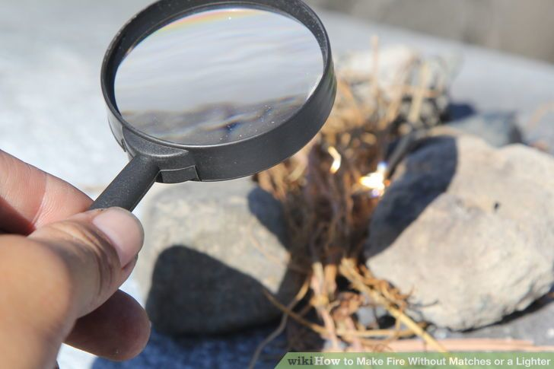
How Big is Your Lens?

Slide 40
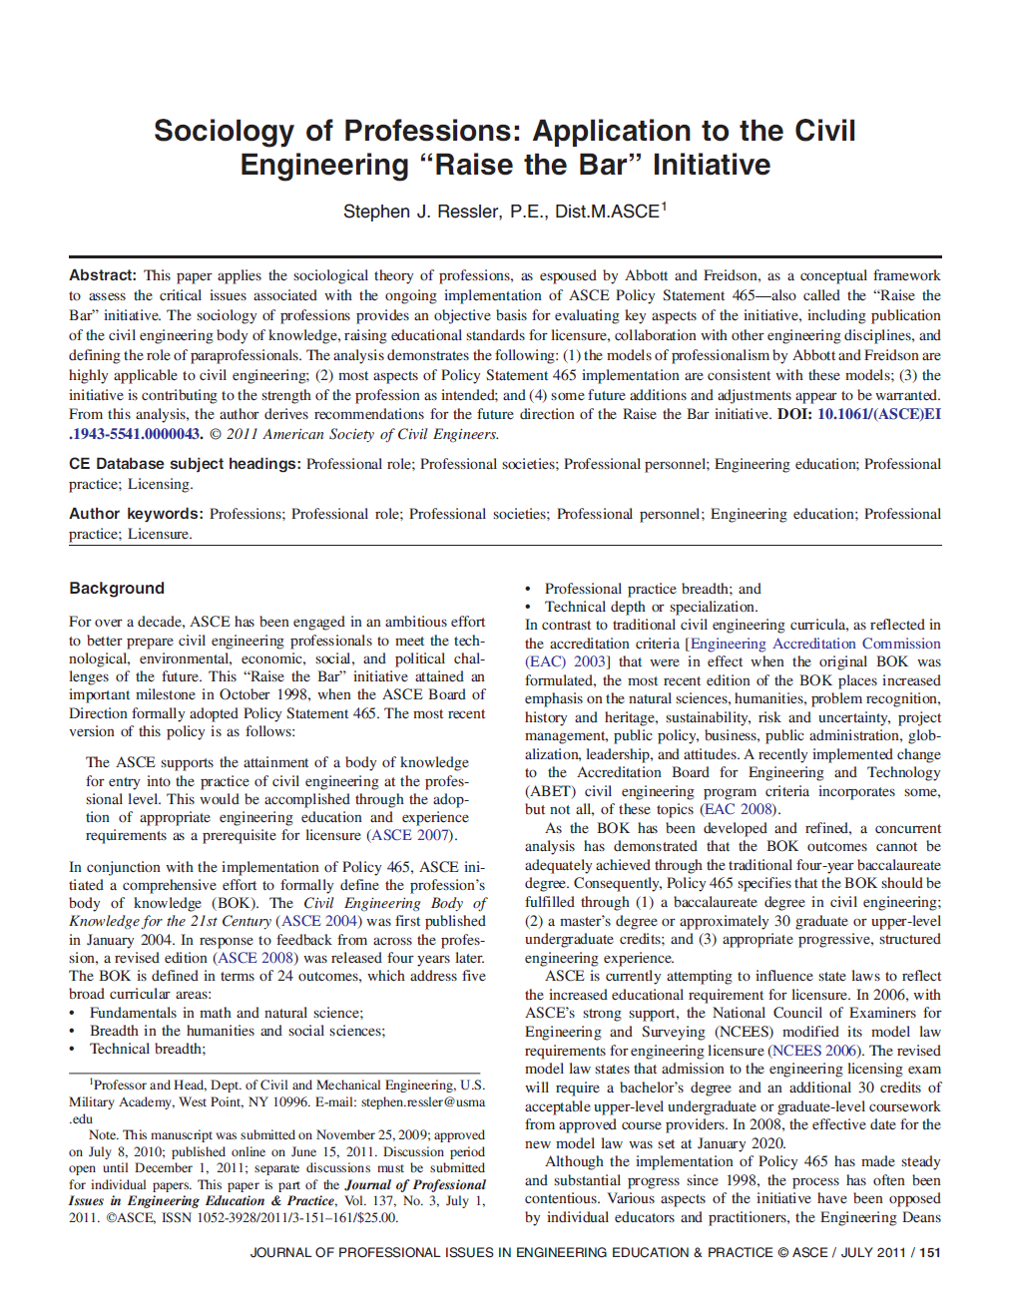
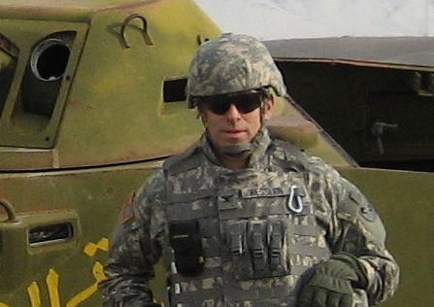
Technical Paper Stephen J. Ressler, PE, PhD Professor US Military Academy at West Point

Slide 41
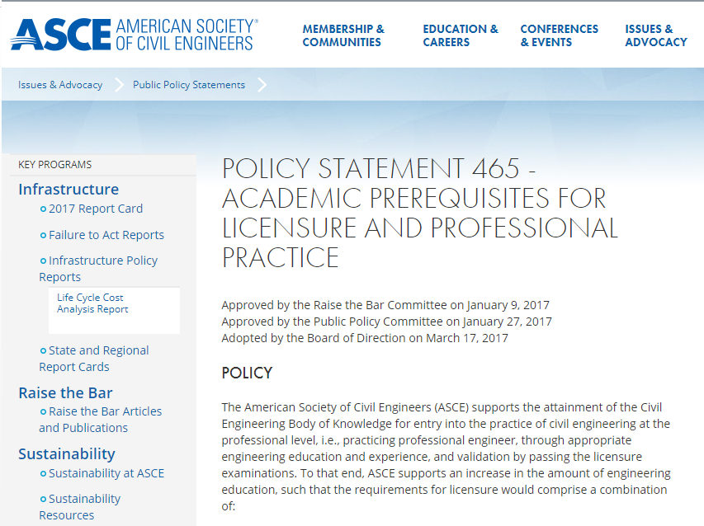
ASCE Policy Statement 465

Slide 42
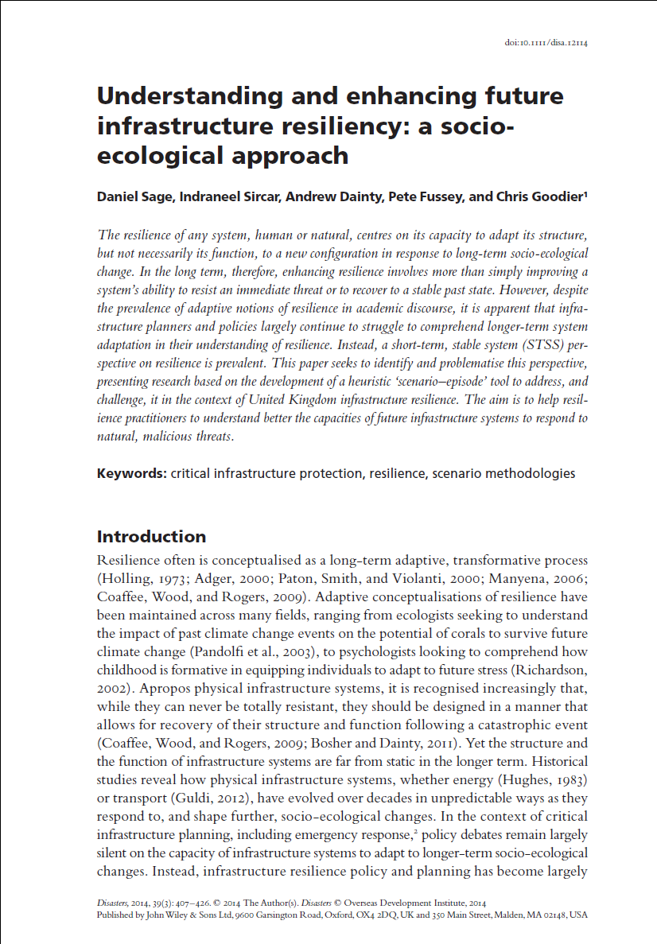

Technical Paper Daniel Sage, et al. Senior Lecturer in Organizational Behavior Loughborough University, UK

Slide 43

Enhancing Resilience…

Slide 44
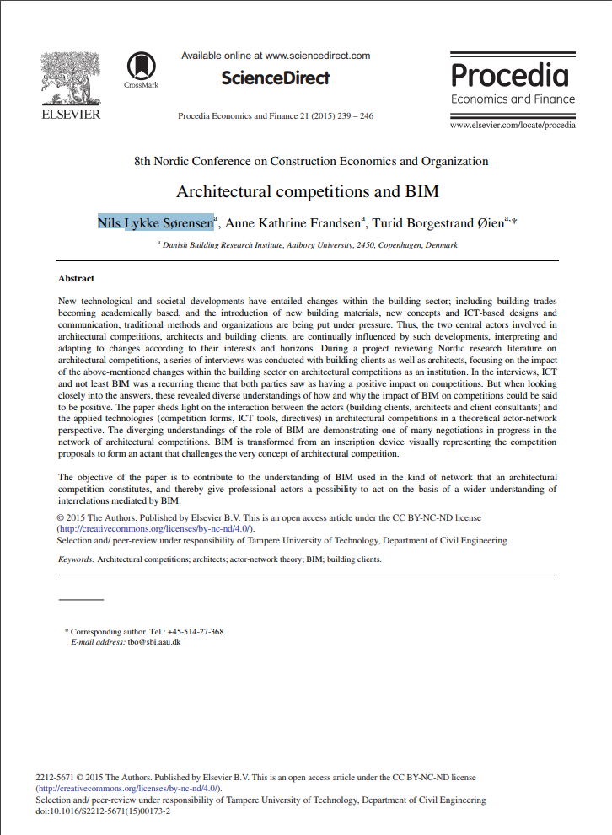
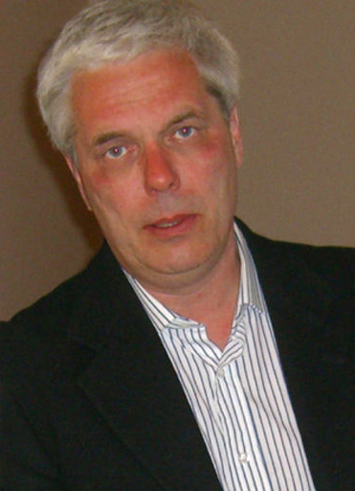
Technical Paper Nils SØrensen, et al. Danish Building Research Institute Aalborg University, Denmark

Slide 45
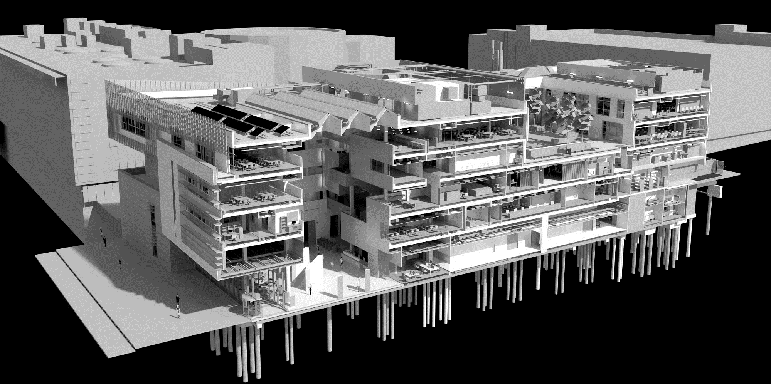
BIM is 10% technology and 90% sociology…

Slide 46

Transportation Training William D. Lawson, et al. Multidisciplinary Research in Transportation Texas Tech University

Slide 47
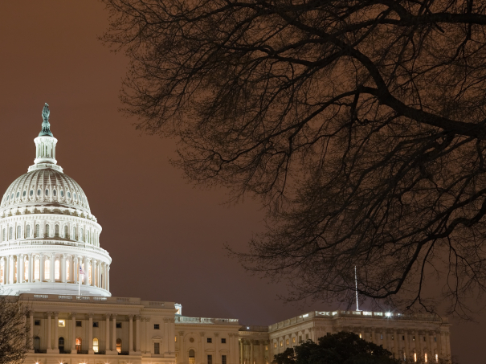
Who Establishes Level of Service (LOS)? RELATIONSHIP BETWEEN LOS AND RESOURCES
FINANCIAL
TECHNICAL
POLITICAL
Funding is established through legislative appropriation
Capabilities are established through technical knowledge
Expectations exist for the traveling public

Slide 48

And we have discussed many more…

Slide 49
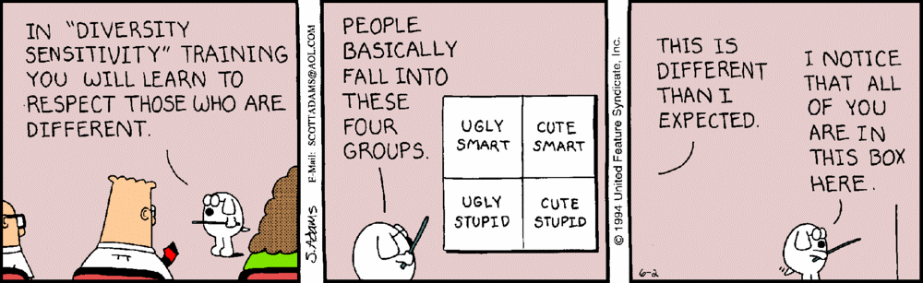
DIVERSITY & INCLUSION…

Slide 50
LICENSING: the product of collaboration between Industry, Government & Education
INDUSTRY
Professional Associations
ABET
NCEES
Program Accreditation
State Licensing Boards
EDUCATION
GOVERNMENT
ABET - Accreditation Board for Engineering and Technology
NCEES - National Council of Examiners for Engineering and Surveying

Slide 51
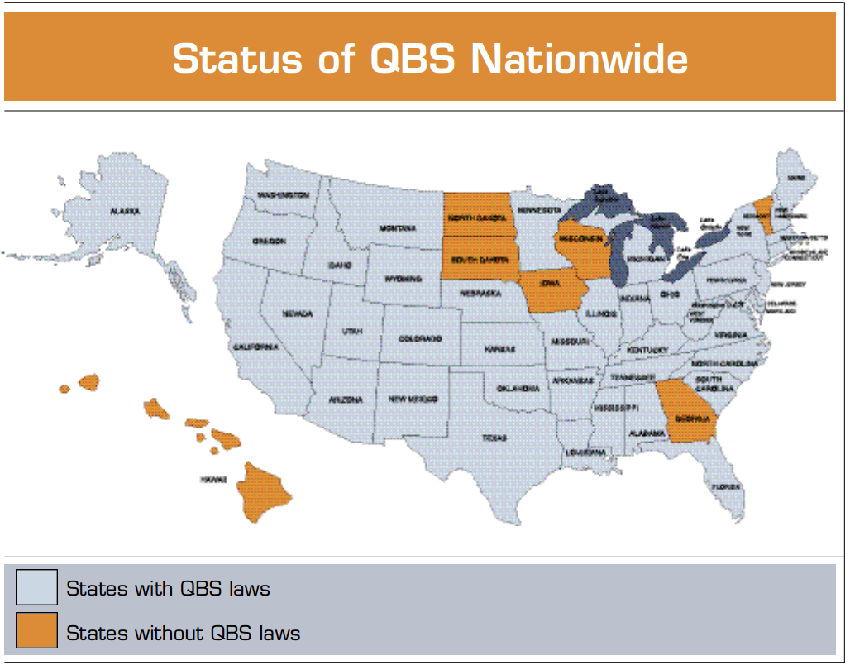
QUALIFICATIONS BASED
SELECTION…
Source: Engineering Inc. (Dec 2002)

Slide 52

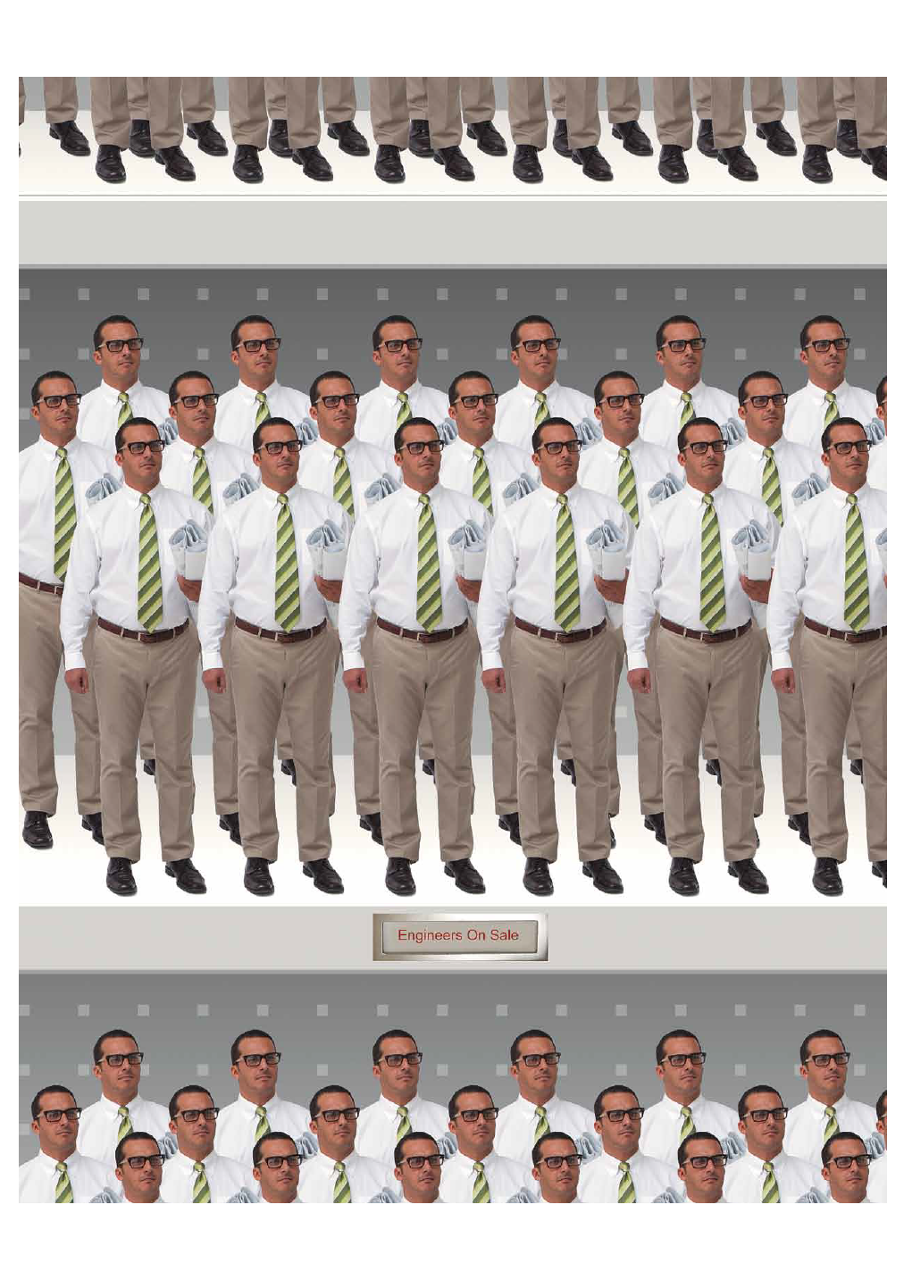
COMMODITIZATION OF
ENGINEERING WORK…
Source: ENGINEERING, INC. March/April 2015

Slide 53
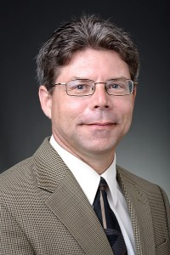
LEADERSHIP…
“An engineer is hired for his or her technical skills, fired for poor people skills, and promoted for leadership and management skills.”
-Jeffery S. Russell

Slide 54

“Trustworthiness is
the first virtue of professional life.”

Slide 55

Social Science… the scientific study of human society and social relationships

